Slide 1
Diagraming Tools

Slide 2
Outline
Discussion: diagrams in daily life
Discussion: diagrams in software design
diagrams.net
Drawing diagrams with the diagraming tool
Discussion: good diagrams

Slide 3



What is a diagram?
A simplified drawing showing the appearance, structure, or workings of something; a schematic representation.
-- a definition from Oxford Languages

Slide 4
How often do we use diagrams in our daily life?

Slide 5
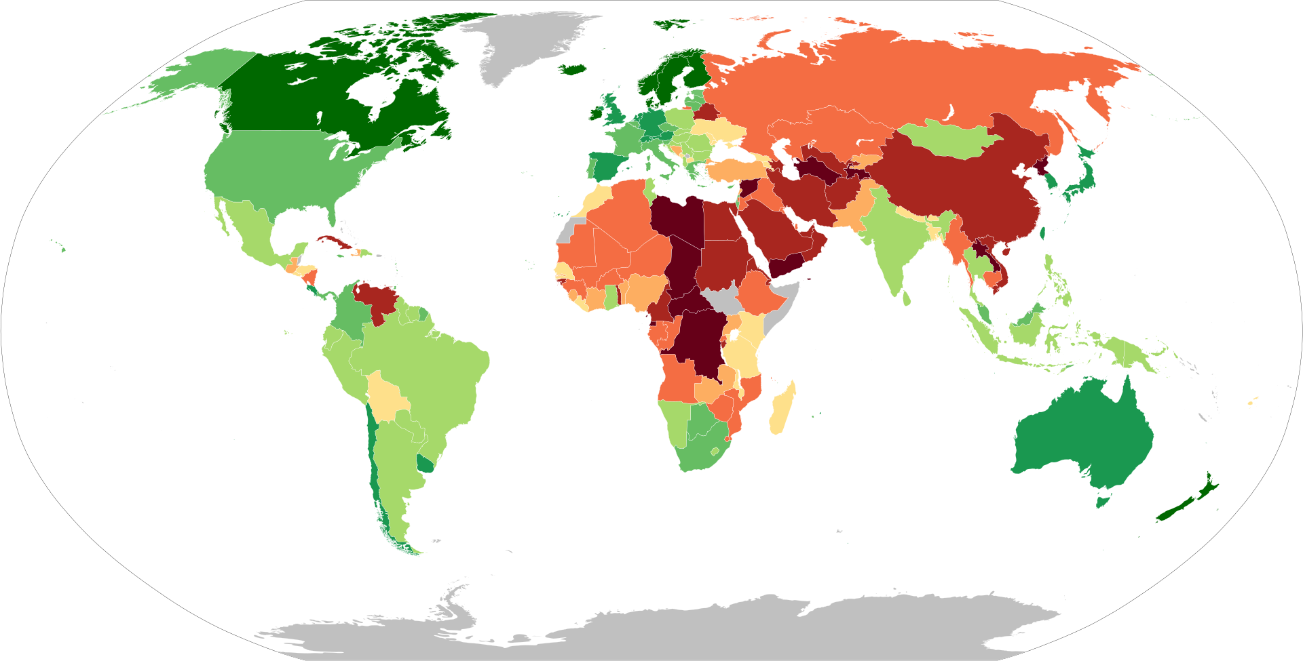
The 2020 Economist Intelligence Unit Democracy Index map

Slide 6
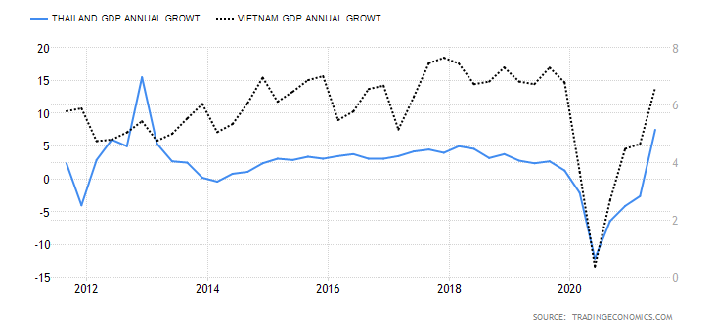

Slide 7
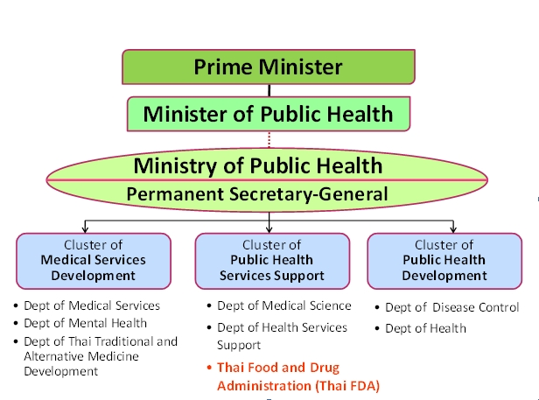

Slide 8
Provide at least 3 reasons why diagrams are important in software design?

Slide 9
diagrams.net
diagrams.net/draw.io is an open-source technology stack for building diagramming applications.
It is the world’s most widely used browser-based end-user diagramming software.
No login or registration required for browser-based software.
Desktop application is also available.
The shapes for UML 2.5 are provided.
https://www.diagrams.net/

Slide 10
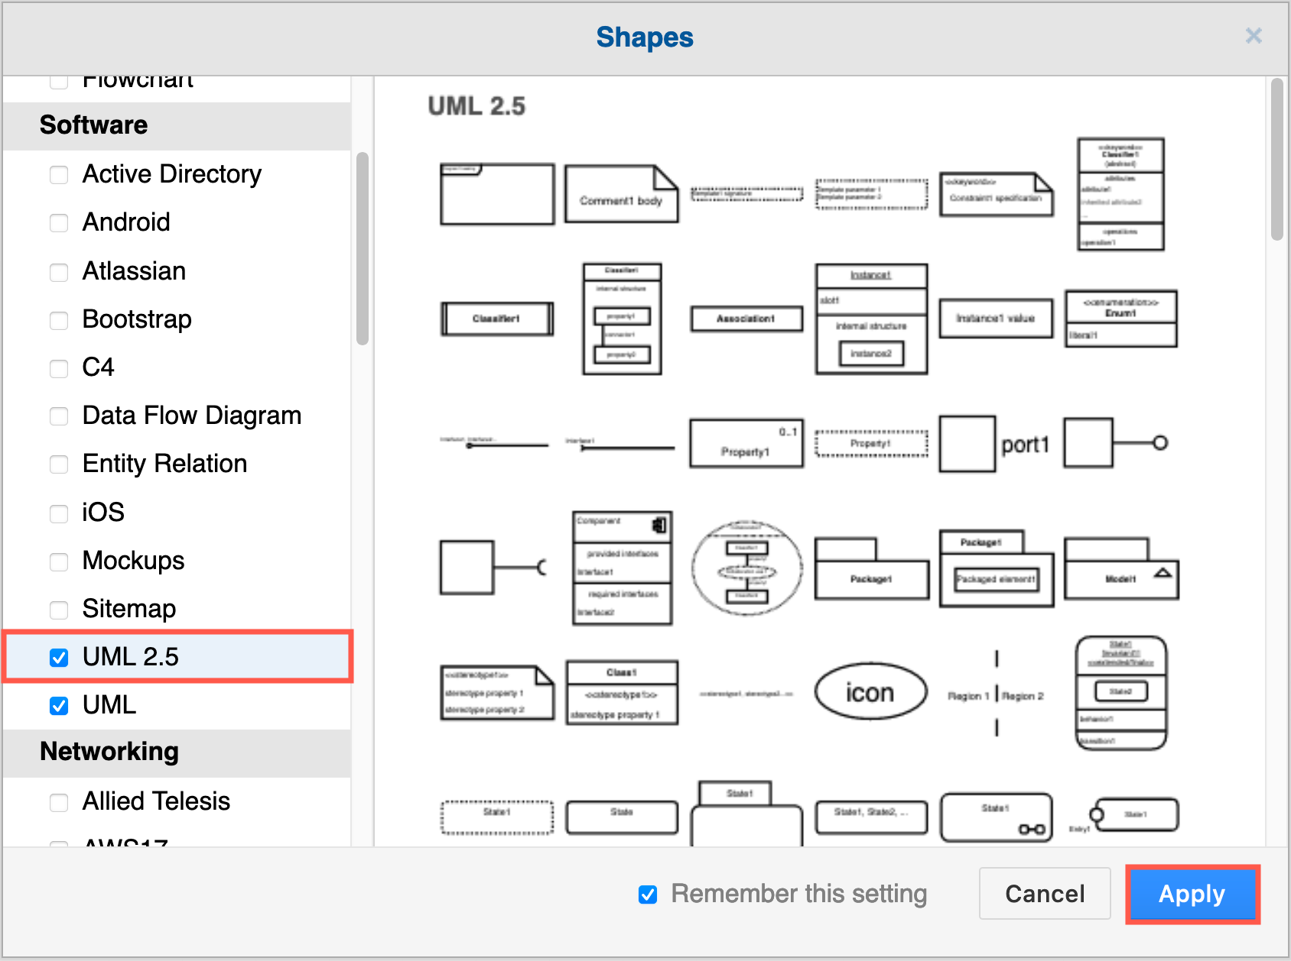
Enable the UML 2.5 shape library
Click on More Shapes at the bottom of the left panel in diagrams.net, scroll down and click on the checkbox next to the UML 2.5 shape library in the Software section. You may want to also enable the UML shape library. Then click Apply.
The UML 2.5 shape library will appear in the left panel.

Slide 11
Let's get our hands dirty!!

Slide 12
Duke's Bookstore
Duke's Bookstore is a simple online shopping web application.
It provides a book catalog from which users can select books and add them to a shopping cart.
Users can view and modify the shopping cart.
When users are finished shopping, they can purchase the books in the cart.
The data for Duke's Bookstore is maintained in a database.
Let us assume that no security feature is needed. (e.g., no login page is required)
Try to draw diagram(s) from the description above. Let’s start with no rule!!

Slide 13
Books in Duke's Bookstore
The Book entity defines attributes used in this example:
A book ID
The author’s first name
The author’s surname
The title
The price
Whether the book is on sale
The publication year
A description of the book

Slide 14
What makes a good diagram?

Slide 15
UNIFIED MODELING LANGUAGE SPECIFICATION VERSION 2.5
https://www.omg.org/spec/UML/2.5/About-UML/

